Slide 1
Progress Iteratively with Feedback

Slide 2

Advantages of an Iterative Approach
Very complex tasks can be much easier accomplished
We should not attempt to do everything at once
Smaller sections of a complex problem could be easier to manage
They also have more chances of delivering in time
The detailed design will emerge as we progress

Slide 3


Traditional Approach Versus Iterative (Agile) Approach
Traditional approach | Iterative (Agile) approach
Linear approach Scope is known right from the beginning Customer presence is not strictly required Tends to deliver outdated outputs Very limited flexibility for new requirements | An iterative, team-based approach Works on a time-boxed, iterative way Relies heavily on feedback loops Increases speed and flexibility Improves quality by early correction

Slide 4
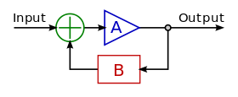
The Importance of Feedback Loops
The context may change DURING the iteration
New priorities may appear and the iteration has to be altered or removed
Feedback Loops may be used to this purpose
(Part of the output of an activity is used for new input)

Slide 5
ITIL Guiding Principles – Part Two
Next Section

